Slide 1


Paper Title: Self-Driving Car Using Deep Learning and IoT Paper ID:275 Presenter’s Name: Amisha Jaiswal Presenter’s Affiliation: Abhishek Jaiswal, Harshit Sharma

Slide 2
OBJECTIVE
Self-Driving Car using Deep Learning and IoT technologies. The objective of this project is to create an autonomous vehicle capable of navigating and operating in real-world environments without human intervention. This concept is commonly referred to as an Advanced Driver Assistance System (ADAS).
Using the amalgamation of deep learning algorithms, real-time image processing, and IoT connectivity, The master device interprets the input data, making informed decisions regarding navigation and control of the self-driving car. This intricate interplay between hardware and software components facilitates a holistic approach toward creating an autonomous vehicle capable of navigating diverse environments with precision and efficiency.

Slide 3
INTRODUCTION
In recent years, self-driving cars have emerged as one of the most promising innovations in the field of transportation. Powered by cutting-edge technologies such as deep learning and the Internet of Things (IoT), these vehicles are poised to revolutionize the way we travel, offering numerous benefits in terms of safety, efficiency, and convenience.

Slide 4
LITERATURE REVIEW
Baduea et al.’s survey [1] is centered on self-driving cars that have completed the DARPA challenge, specifically those that have reached SAE level 3 or above in autonomy. With a focus on UFES’s IARA, the study offers an in-depth analysis of the design, functions, and subsystems of the perception and decision-making systems in these cars. The report also identifies prominent academic and tech company research platforms for self-driving cars..
By conducting a survey on the function of deep learning in self-driving cars and highlighting its effects on social and economic development, Ni et al. [2] make a valuable contri bution to the field. Deep learning applications in self-driving car domains such as obstacle detection, scene recognition, lane detection, navigation, and path planning are investigated in this research. In addition to providing a summary of current advancements, the survey explores the difficulties and potential solutions related to using deep learning techniques in autonomous cars.
In their discussion of the changing field of Intelligent Traffic Systems (ITS), Chowdhury et al. [3] place particular emphasis on cooperative ITS, or connected vehicles. The development of cyber-physical systems that can make decisions on their own for use in autonomous vehicles and unmanned aerial systems is the main focus of the study. Crucially, the paper presents cyberattacks, their effects, and vulnerabilities by analyzing actual attacks that have been directed towards self- driving cars in a novel way. Along with a discussion of government and manufacturer-implemented mitigation strategies, the arti cle examines how resilient self-driving cars are to ongoing cyberattacks.

Slide 5
Kaur et al. [4] stress the value of thorough testing in the field of testing self-driving cars and suggest simulation testing as a workable substitute. The article lists the essential specifications for a successful simulator and contrasts popular models, with an emphasis on cutting-edge models like CARLA and LGSVL. There is also discussion of the difficulties simulation testing faces in the development of fully autonomous vehicles.
By putting out a ROS2-based architecture for a self-driving car, Reke et al. [5] advance the field. In their defense of ROS2, they highlight the technology’s capacity for dependable and safe real-time behavior, particularly in applications where user safety is paramount, such as self-driving cars. Preliminary trials conducted on an actual passenger vehicle demonstrate the practicability of this method for real-time autonomous driving.

Slide 6
METHODOLOGY
Raspberry Pi Camera
Raspberry Pi
Arduino UNO
L298N Motor Driver

Slide 7
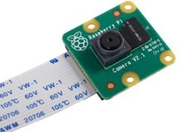
Raspberry pi Camera
We are using a V2 version of the pi-camera, which has an IMX219 sensor, an F2.9 aperture, and an 8MP camera capable of recording at up to 180p30 resolution. This Pi cam takes pictures of the environment and transfers them to the raspberry pi for additional processing. It is adaptable for a variety of uses because it can record videos in addition to taking still photos.

Slide 8
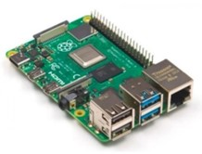
Raspberry Pie
The Raspberry Pi is the main processor here. Popularly known as low- cost single board computer. We are using the Raspberry Pi 3B+ version for image processing. With the help of open CV software, a machine learning algorithm is implemented and the images are trained in various lighting conditions using neural network technology. Further, the de- cisions taken by the Raspberry Pi are sent as commands to Arduino.

Slide 9
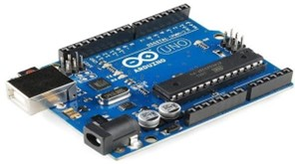
Arduino Uno
The Arduino UNO microcontroller board is based on the ATmega329P. It is very well-liked for small projects. The Arduino platform is utilized in our project to regulate the vehicle’s left, right, forward, and backward movements. Using the Arduino IDE, every function has been preprogrammed in Arduino. Following receipt of the command from the pi, the Arduino will signal the motor driver circuit to perform the necessary movement as directed by the Arduino. Because of its accessibility for novices and its extensive developer community, it is frequently utilized for small-scale projects. The Arduino Integrated Development Environment (IDE), a user-friendly platform for writing and uploading code, can be used to program Arduino boards. Based on the commands received, the Arduino code uses logic to control the vehicle’s movement. The code activates or deactivates particular pins connected to the motor driver circuit for each type of movement (forward, backward, left, and right).

Slide 10
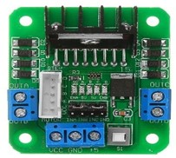
L298 Motor Driver
It is a basic motor driver module used to drive DC motors as well as stepper motors. H bridge is used along with L298 IC to drive motors. H bridge is a circuit that can drive current in polarity and will be controlled by pulse width modulation.

Slide 11
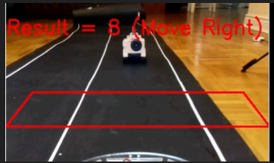
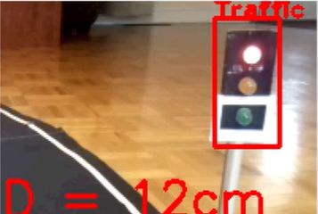
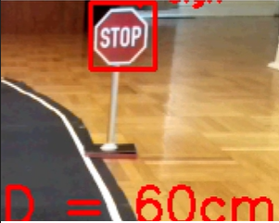
RESULT
Obstacle Detection
Traffic Light Detection
Stop Sign Detection

Slide 12
FUTURE SCOPE
Commercialization of Autonomous Vehicles: Autonomous vehicles are expected to play a significant role in the future of transportation. Major automotive companies and tech firms are investing heavily in self-driving technology. There is a growing market for self-driving taxi services, delivery vehicles, and other autonomous transportation solutions.
Advanced Machine Learning and AI Machine learning and artificial intelligence will continue to play a crucial role in the development of self-driving cars. The scope includes refining algorithms for better decision-making, object recognition, and handling complex scenarios on the road

Slide 13
Refrences
[1]. Baduea, C., Guidolini, R., Carneiro, R. V., Azevedo, P., Cardoso, V. B., Forechi, A., ... De Souza, A. F. ”Self- Driving Cars: A Survey.” 2 Oct 2019.
[2]. Ni, J., Chen, Y., Chen, Y., Zhu, J., Ali, D., Cao, W. ”A Survey on Theories and Applications for Self-Driving Cars Based on Deep Learning Methods.” 16 April 2020.
[3]. Chowdhury, A., Karmakar, G., Kamruzzaman, J., Jolfaei, A., Das, R. ”Attacks on Self- Driving Cars and Their Countermeasures: A Survey.” 27 November 2020.
[4]. Kaur, P., Taghavi, S., Tian, Z., Shi, W. (2021). ”A Survey on Simulators for Testing Self Driving Cars.” 13 Jan 2021.
[5]. Reke, M., Peter, D., Schulte-Tigges, J., Schiffer, S., Ferrein, A. ”A Self-Driving Car Architecture in ROS2.” 2020.

Slide 14
Thank You

